Slide 1
LayerCode: embeds barcode in 3D printed object (additive manufacturing)

Slide 2
可以做的改进(from sec6. evaluation)
研究鲁棒性：研究编解码方法和识别方法对于遮挡、同色背景的抵抗力（文中研究的基本都是没有遮挡、前背景大对比度）
研究速度：优化graph-based approach来降低解码时间/解码时间上界 -> feasible on mobile devices
研究信息容量：ternary or quaternary（三元/四元）打印可以提高信息容量
姿态估计
近期计划工作
跑跑看LayerCode的源码
Tracking论文

Slide 3
sec1. introduction
Encoding algorithm
Decoding algorithm (from single photo)
Test with large dataset of virtual rendering (4000+ shapes from Thingi10k dataset 2016, 99% successfully encode & decode)
Embedding optical tags: on, beneath, inside the surf (ref)
Challenges:
robust encoding & decoding:
standard barcode-maps every bit to a bar thickness
we-encode bits based on local change of layer thickness (invariant under diff. orientation)
image-paths along for decoding
2. need to introduce 2 distinguishable layer types:
2 material printer OR diff deposition height OR mix NIR dye

Slide 4
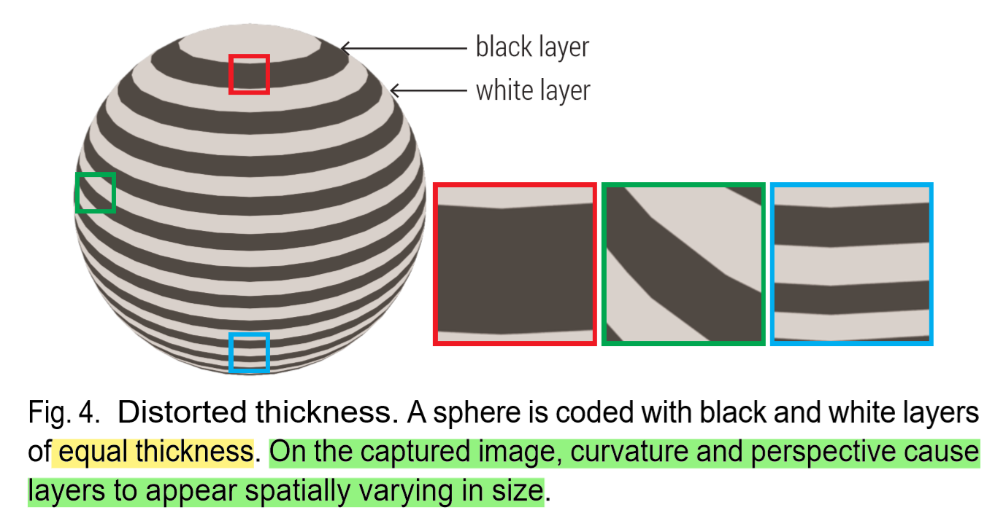
sec1. introduction
Attributes:
* conventional cam (NIR with filter and light source when detecting)
* redundancy: readable from multiple cam view and even broken
* depth info for free: parallel light pattern -> use structured light tech in CV
how???
Output of encoding algorithm: a series of slices along the printing direction to specify the thickness of each coding layer
Cannot transfer flat barcode’s pattern directly: because of spatially variant
solution: use thickness ratio of 2 consecutive
layers in a local region (because they share
the approx. same surface tangent plane)

Slide 5
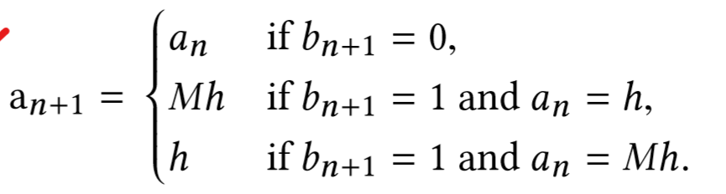
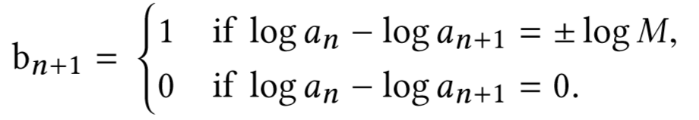
sec3. encoding
Coding scheme details: bn -> an
an: thickness
bn: bit
an+1 : an = 1 if bn+1 = 0
an+1 : an = 1/M or M if bn+1 = 1 the proposed pipeline used M = 2
inverse map for decoding:

Slide 6
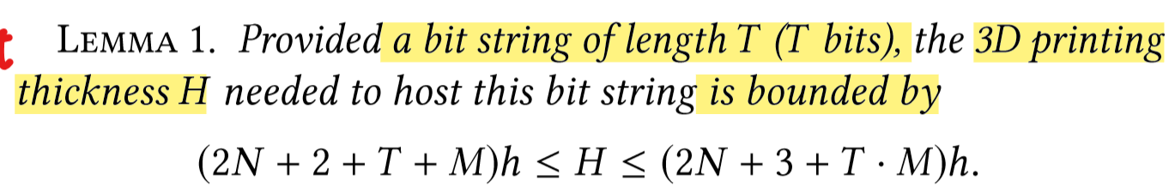
sec3. encoding
Coding scheme details: bn -> an
start of bit string: a layer with an = Nh (the proposed pipeline used M = 4), followed by 2 layer with thickness = h (bit 0 as the head of the bit string)
end of bit string: a single layer appended to form bit 1 as the rear of the bit string, with the last layer is again an = Nh after the appended layer
the bit string always starts with 0 and ends with 1: direction or the barcode can be tell

Slide 7
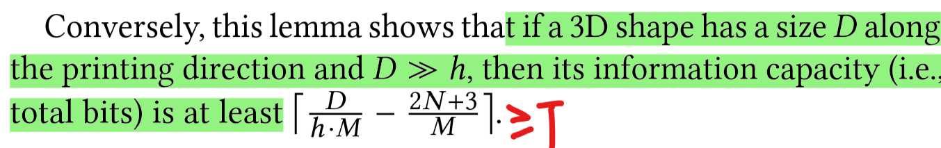
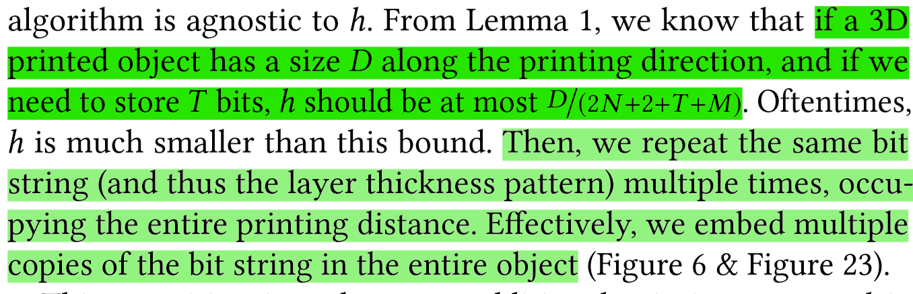
sec3. encoding
Error correction: is able to carry any error-correction code as long as enough bit string length (no correction code in experiment to test pure performance)

Slide 8
Decoding pipeline
Preprocessing: distinguish ‘white bar’ & ‘black bar’
Graph construction
Graph traversal

Slide 9
sec4. decoding
Image preprocessing: see algorithm 1 & appendix A
1. 2-color printer:
1) intensity thresholding: remaining pixels are either on black or white layer color thresholding???
2) 2-way clustering through GMM in a sliding window: each window produces the label of its central pixel, repeat 3 time with diff. size how???
3) pixel-wise majority vote of labels how???
helpful to convert to LAB/HSV, focus on AB channel when clustering

Slide 10
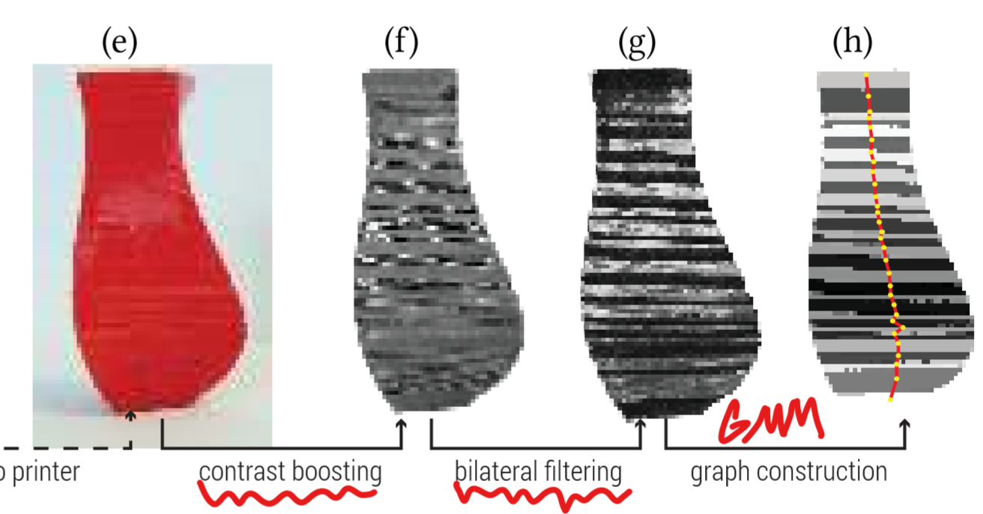
sec4. decoding
Image preprocessing: see algorithm 1 & appendix A
2. varying layer height objects:
1) remove the background (color thresholding???) -> greyscale
2) morphological operation:
bottom and top hat filtering -> increase contrast how???
bilateral filter (ref) -> blur black & white layer regions without blurring boundary
GMM-based clustering -> binarize the image how???

Slide 11
sec4. decoding
4.1 graph construction
Flood fill process -> all pixels are either labelled black or white -> formed black regions & white regions -> each regions is a node, 2 nodes are connected if their regions are adjacent
Edge e (connects node A & B)
vector v of e: denotes general direction to move A -> B
* identify boundary pixels in region A: pixels within \delta pixels away from another region (in paper \delta = 3) how???
* estimate boundary normal direction (quickest direction to get into another region from current boundary pixel (深度优先搜索???)
* v is the avg normal direction over all boundary pixels between A & B

Slide 12
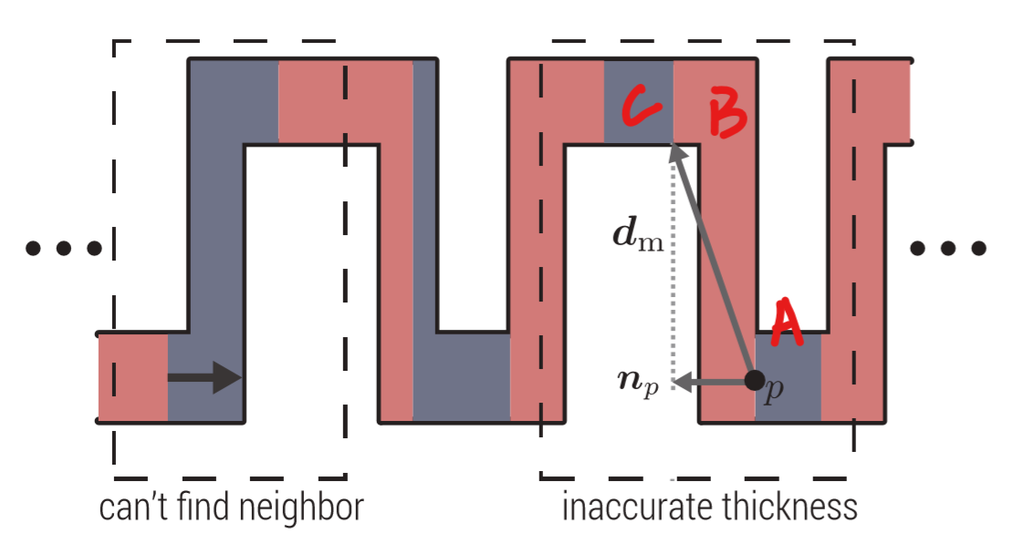
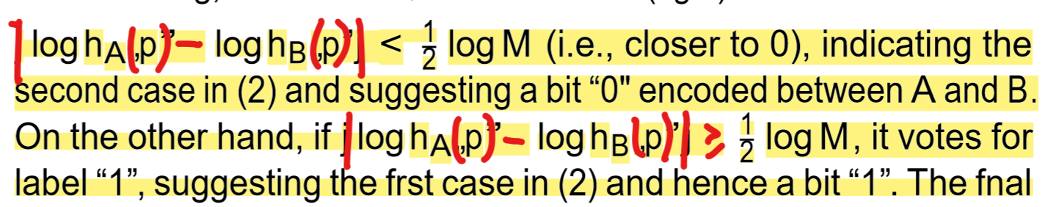
sec4. decoding
4.1 graph construction
Edge e (connects node A & B)
label r of e:
* thickness estimation: for each boundary pixel p between A & B, find a shortest image plane vector dm between p and another region (not A or B but C) (深度优先搜索???), project dm onto np to estimate thickness of a layer -> now hA(p) & hB(p) are known
* get bn: use 0.5logM as a threshold

Slide 13
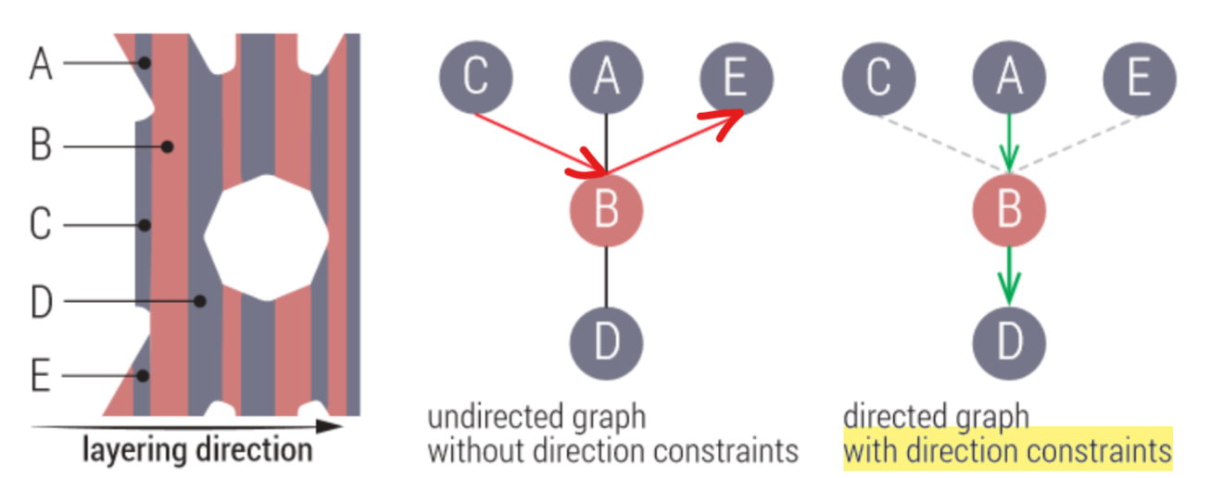
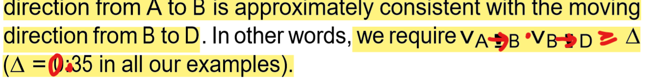
sec4. decoding
4.1 graph construction
Edge e (connects node A & B)
feature label r: indicates the bit of the edge (edge = 1 bit)
unknown M? -> regard x = |loghA - loghB| as a random variable, the distribution of x must be a 2-peak GMM!!! Center 1 at 0, center 2 at logM -> use maximum likelihood estimation to estimate logM (p(logM) in GMM must have highest pdf except for p(0)) h? not imprt., can be set as prior OR encode it in the object
Identify starting & ending nodes: outliers in GMM!!! Use a set S to contain
4.2 decoding through graph traversal
DFS: repeatedly DFS start from a node
in set S. use edge vector to make sure
direction consistency (otherwise: loop)

Slide 14
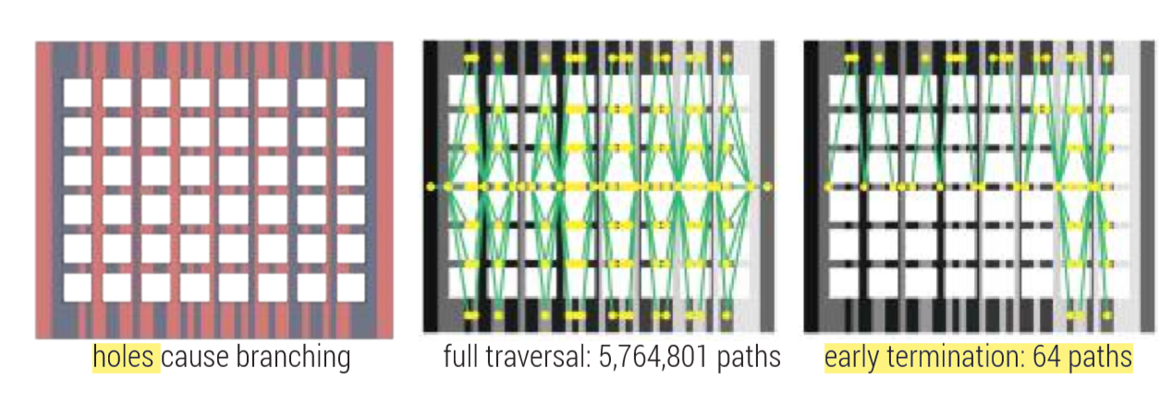
sec4. decoding
4.2 decoding through graph traversal
traversal stops: another node in S is reached OR DFS runs out of unvisited(fatal error, because the bit string should always end with bit 0)
4.3 early termination
Terminate the graph traversal if we have surveyed a sufficient number of paths: terminate decoding once num_path ≥ K (num_path is counted in DFS)
Terminate if: Current individual
decoded bits (not string) have
80% in common

Slide 15
sec4. decoding
4.4 depth recovery
4.4 & Appendix B：没看懂

Slide 16
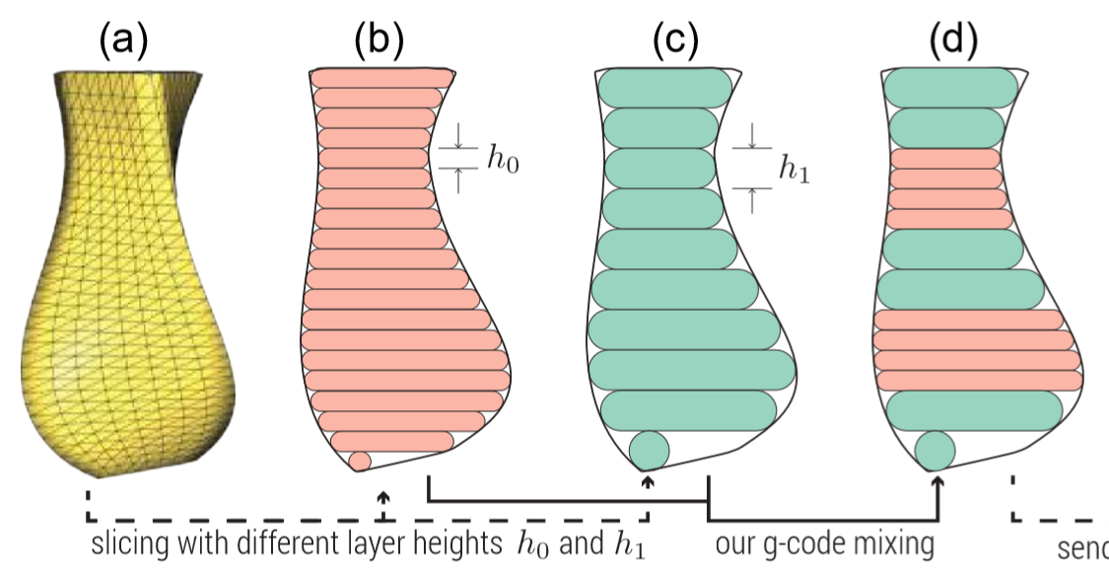
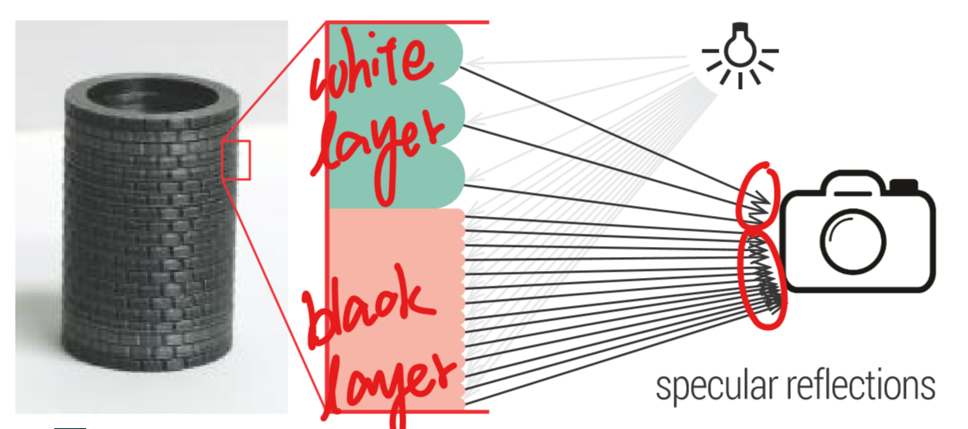
sec5. fabrication
5.1 2-color fabrication (for multi-material 3D printers)
Produce LayerCode without any modification to software/hardware
5.2 variable layer heights
Black layers: h0 for each layer?
white layers: h1 for each layer?
specular high light
green region: spare & granular(颗粒状的
red region: dense & uniform
difference of highlight distribution
-> allows decoding to discern(分辨
2 types of layers in preprocessing

Slide 17
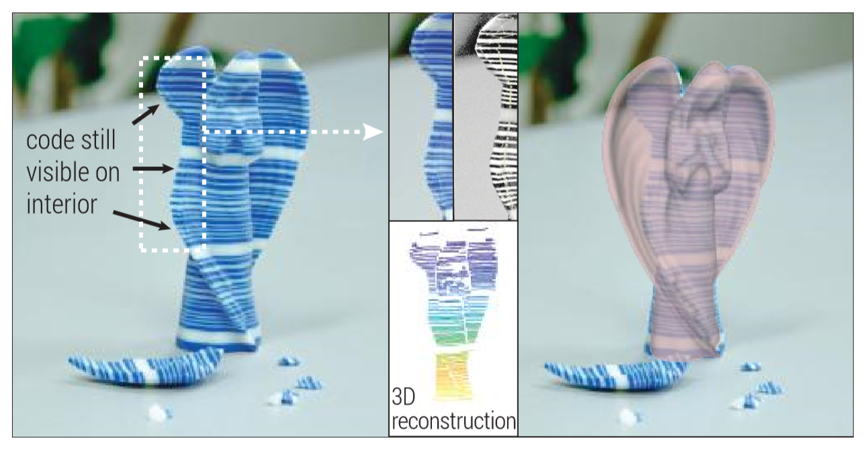
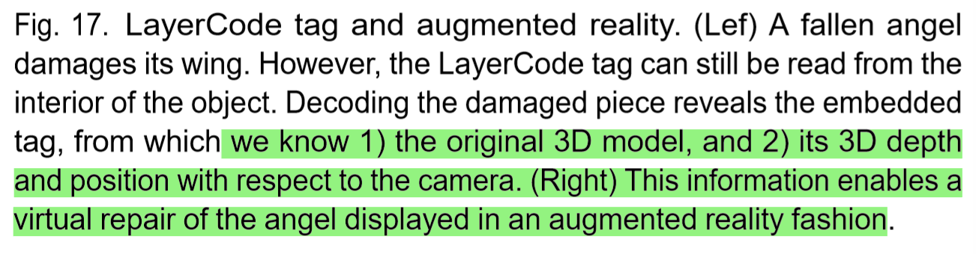
sec5. fabrication
5.2 variable layer heights
Interweave G-code for h0 and h1 at specific location, to construct alternating printing heights (the paper used h1 as integer multiple of h0, to ensure seamless switches across layer heights)
5.4 discussion on implementation & application
40 min to several hours
2-color & variable layer height: time cost comparable to that w/o LayerCode

Slide 18
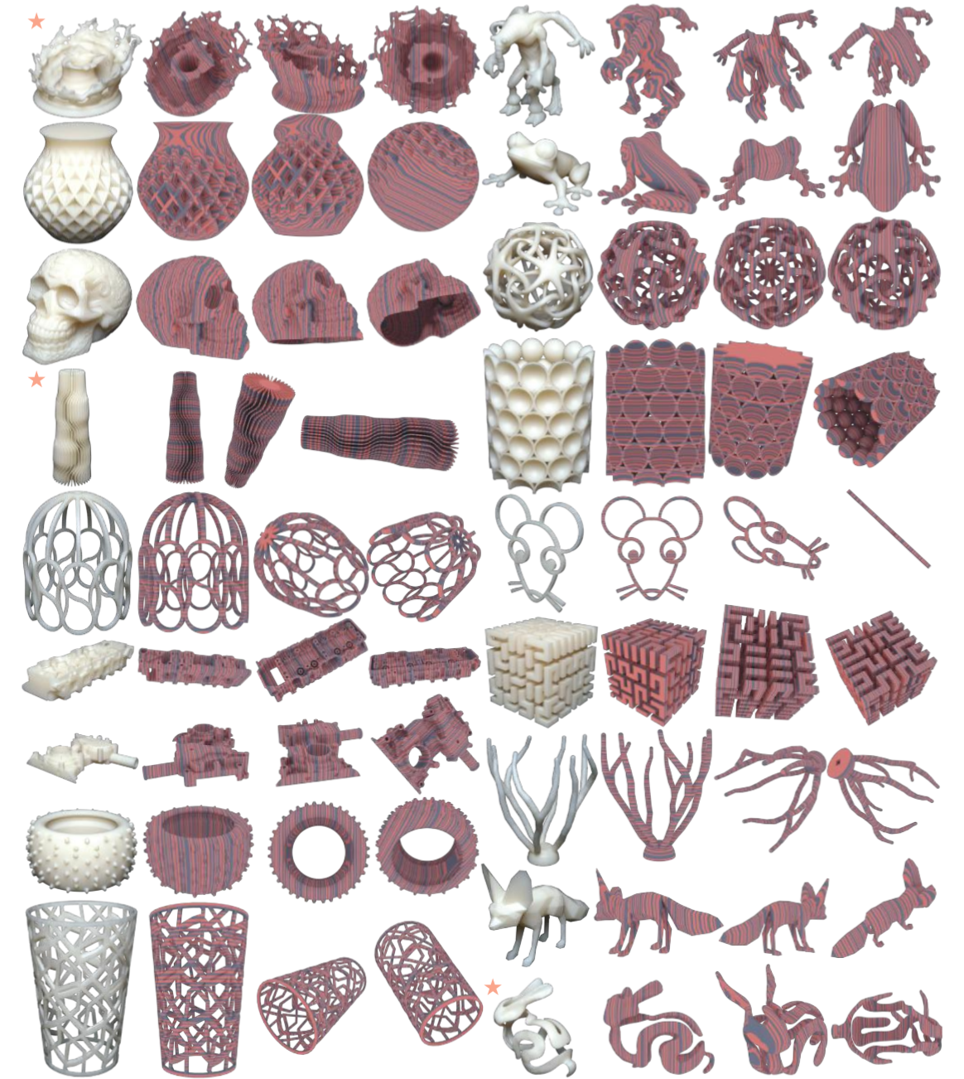
sec6. evaluation
6.1 database construction
4835 Shape meshes from Thingi10k dataset
(ref)
Embed a LayerCode indicating model’s ID
Printing direction: longest dimension
Baseline layer thickness h: set to repeat the tag
3 times
Use Mitsuba(ref) to render the encoded output
Test influence of viewpoint: sample 30
viewpoints

Slide 19
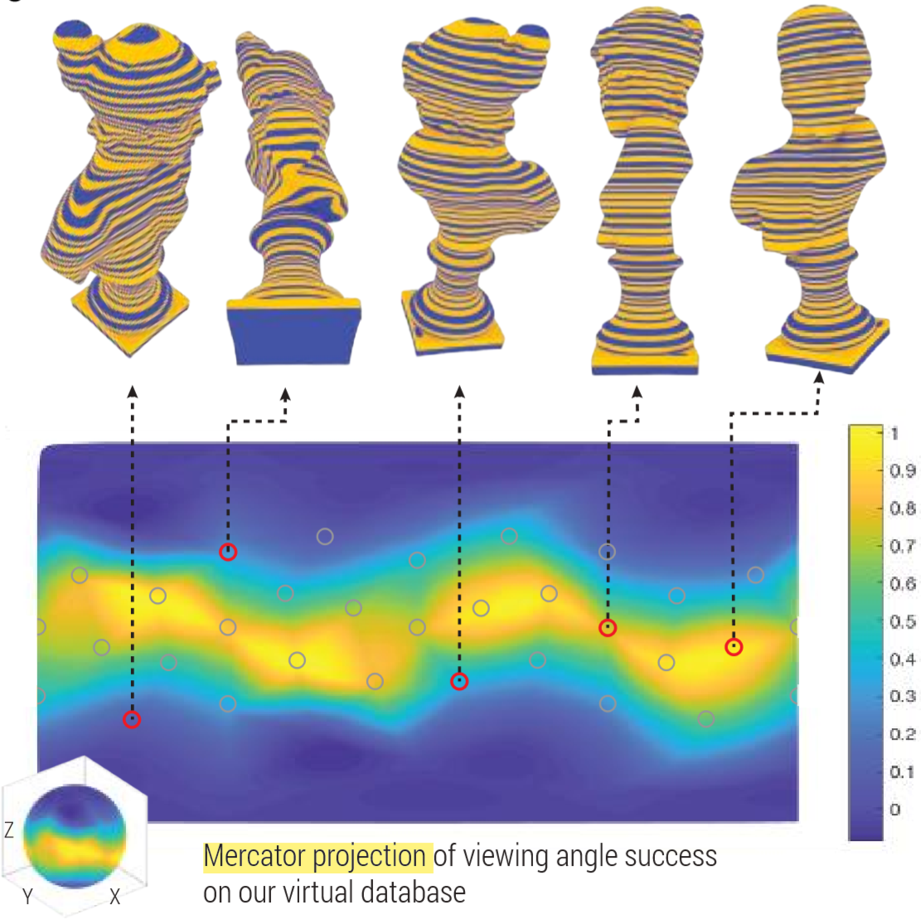
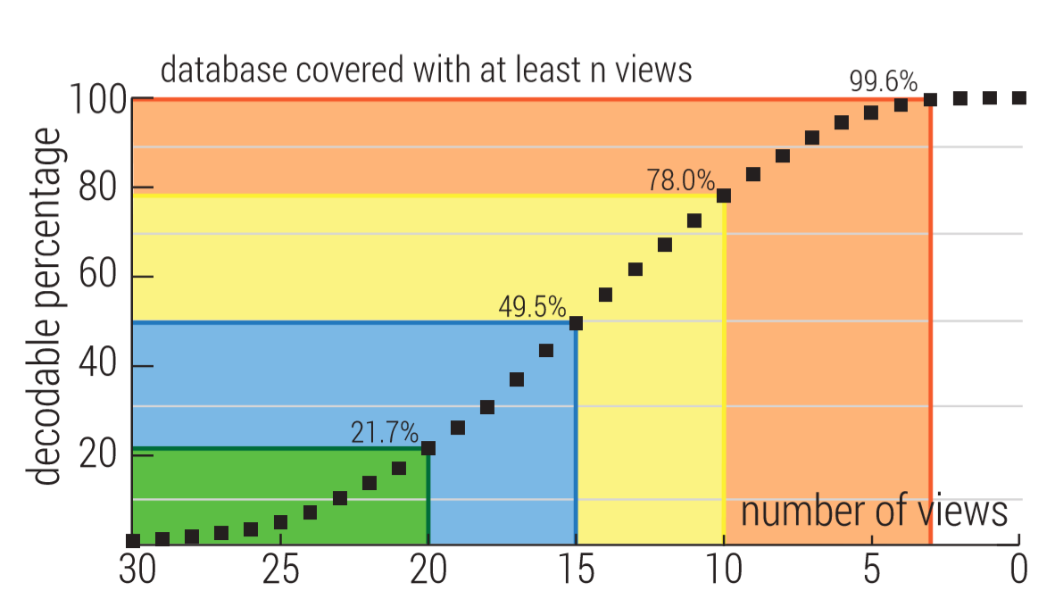
sec6. evaluation
6.2 result statistics
Camera angle dependency

Slide 20
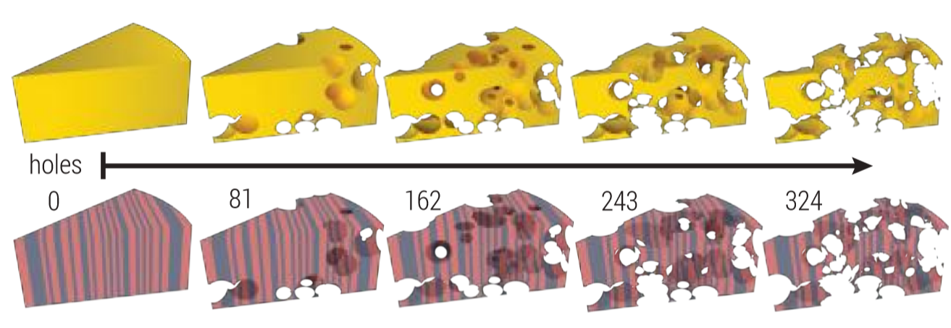
sec6. evaluation
6.2 result statistics
Decoding time: seconds-5 min, complexity is derived from graph approach
-graph building operations (image processing, neighbor region dis, masking)
-image resolution
-shapes, holes, occlusions -> number of nodes -> decoding time
-partly because Matlab
-partly because wish to explore sufficient paths for robust decoding
Lower bound of h
Complex shapes: 4791 successful shapes
, 44 failure cases
Stress test
Failure cases

